Slide 1
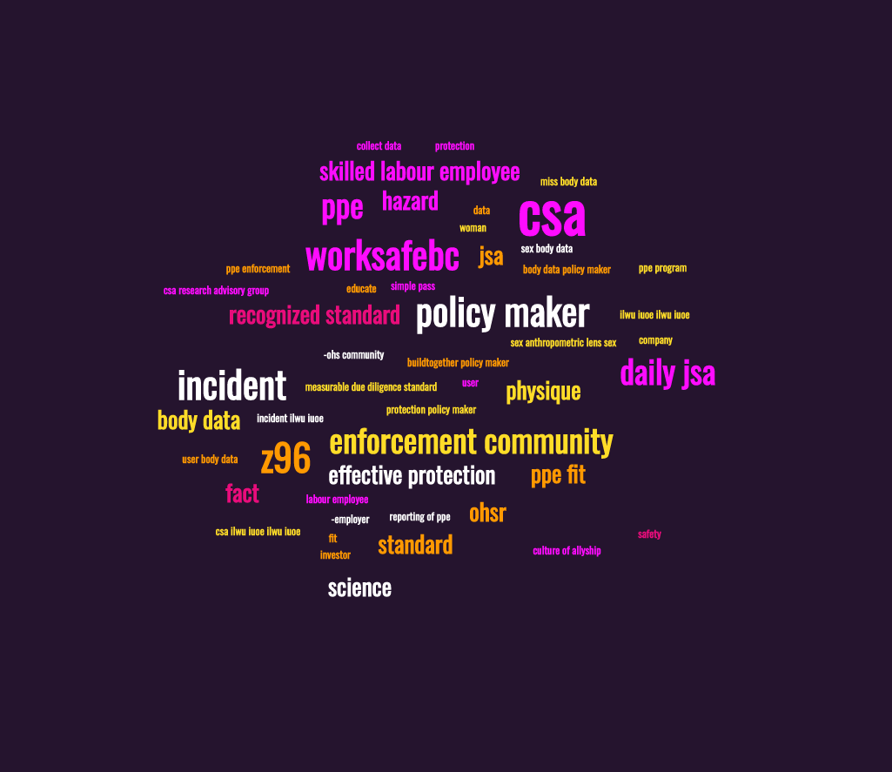
The truth behind our ill-fitting PPE
jodi@helgawear.com @HelgaWearInc
Notes:
I’m here to share my story … shed some light
-see this word cloud
To lay out the plain facts
name
pronouns
Acknowledgement - I am privileged to…..on the lands belonging to…Squamish, Musqueum, T’sleil
I am trained as
I am the founder of Helga Wear
I am an advocate for Inclusive Standards in Canada
First time in front of a construction safety crowd
DISCLOSURE: For the purpose of this talk, please let the word woman refer to: cis or trans gendered, non-binary, gender fluid or non-confrming persons
how I got here….a question I get asked all the time:

Slide 2
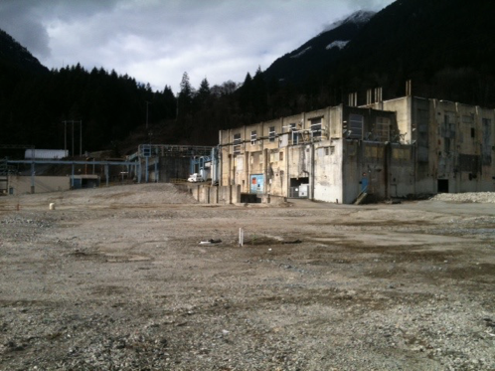
Why did I leave engineering?
Notes:
Why did I leave engineering and found Helga Wear?
Well, why do loads of women leave trades?
Let’s take a look at one of my job sites, for environmental consulting firm
-hold cad specs, report to ministry/client
-sampling, water, soil, vapours
-I conducted the H&S tailgate meetings, filled out and collected the daily job safety analyses sheets
-I was measured on productivity stats my ability to get sub-contracted trades to finish jobs on time and in budget
So I had to win them over
I know, I went into a non-traditional field for a woman.
There are certain things that I just accepted…male culture… tough, the PPE was obviously made for a man
but was it unreasonable for me to expect my PPE to be safe?
Well, I didn’t feel safe in my PPE.
List my PPE
Issues:
Fit - sewing/modifying,
Anatomy - toileting

Slide 3
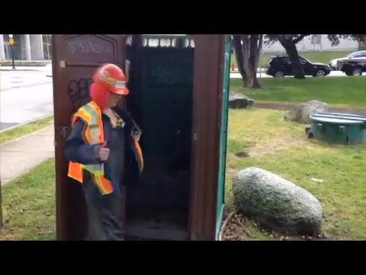
Notes:
Therefore - OPPORTUNITY COST to toileting, and I toileted more than my male colleagues
Productivity metrics: annual bonuses, field work
So the cost/impact to me just from not being able to toilet
-safety
-productivity
So I reached out to other women at work
-don’t drink
-wait to pee
Over time I developed abnormal hydration and toileting behaviours
Impacted: sleep patterns, urinary tract, immune system
I didn’t connect the dots ….behaviour at work …to health effects
-RECAP: my PPE didn’t make me feel protected, or professional, and toileting came at a cost: productivity, safety, health
So…as this is happening, because I’m a sewer, I started modifying my bib overalls
Also of note: even though I was responsible for H&S tailgate meetings…
My PPE-related near misses/hazards didn’t make it onto my JSA’s
SO - once I had made a design that let me take a quick leak outdoors, with dignity, feeling safe, it saved me at least an hour a day, and I got to drink/hydrate like the guys again. I felt called to take it to market, because maybe it could help other women too? At least women deserve options of PPE designed for their anatomy.
THAT is the answer to the question - why leave engineering…
NOW fast forward to 2019

Slide 4
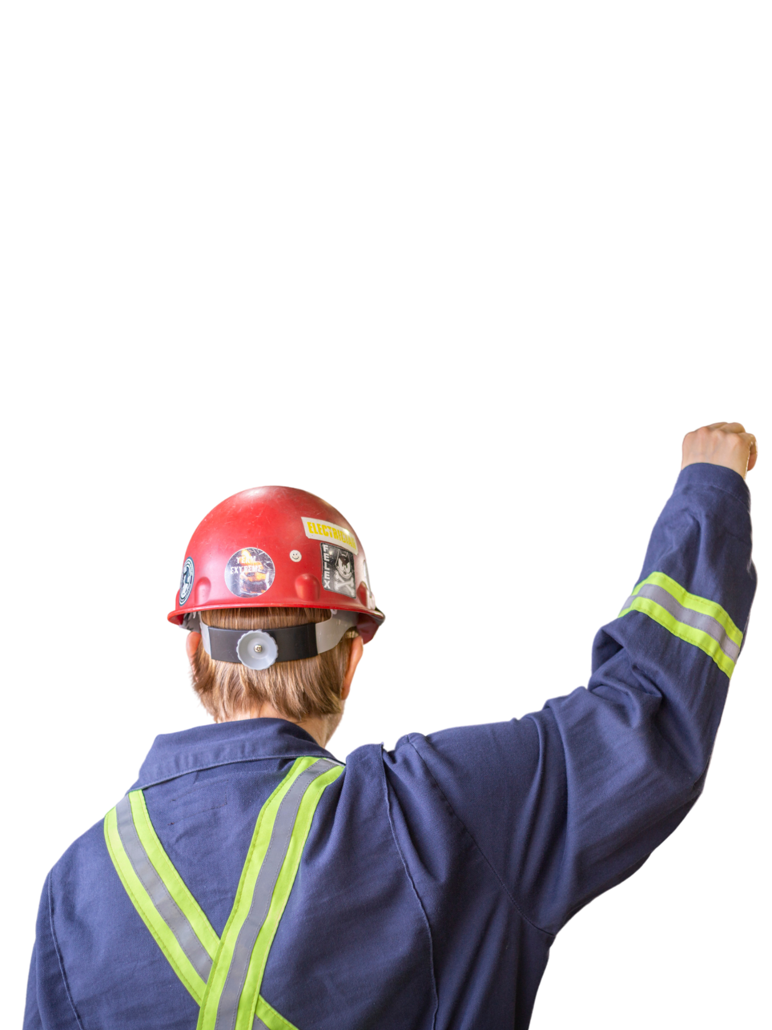
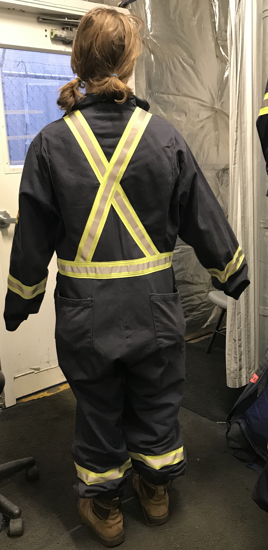
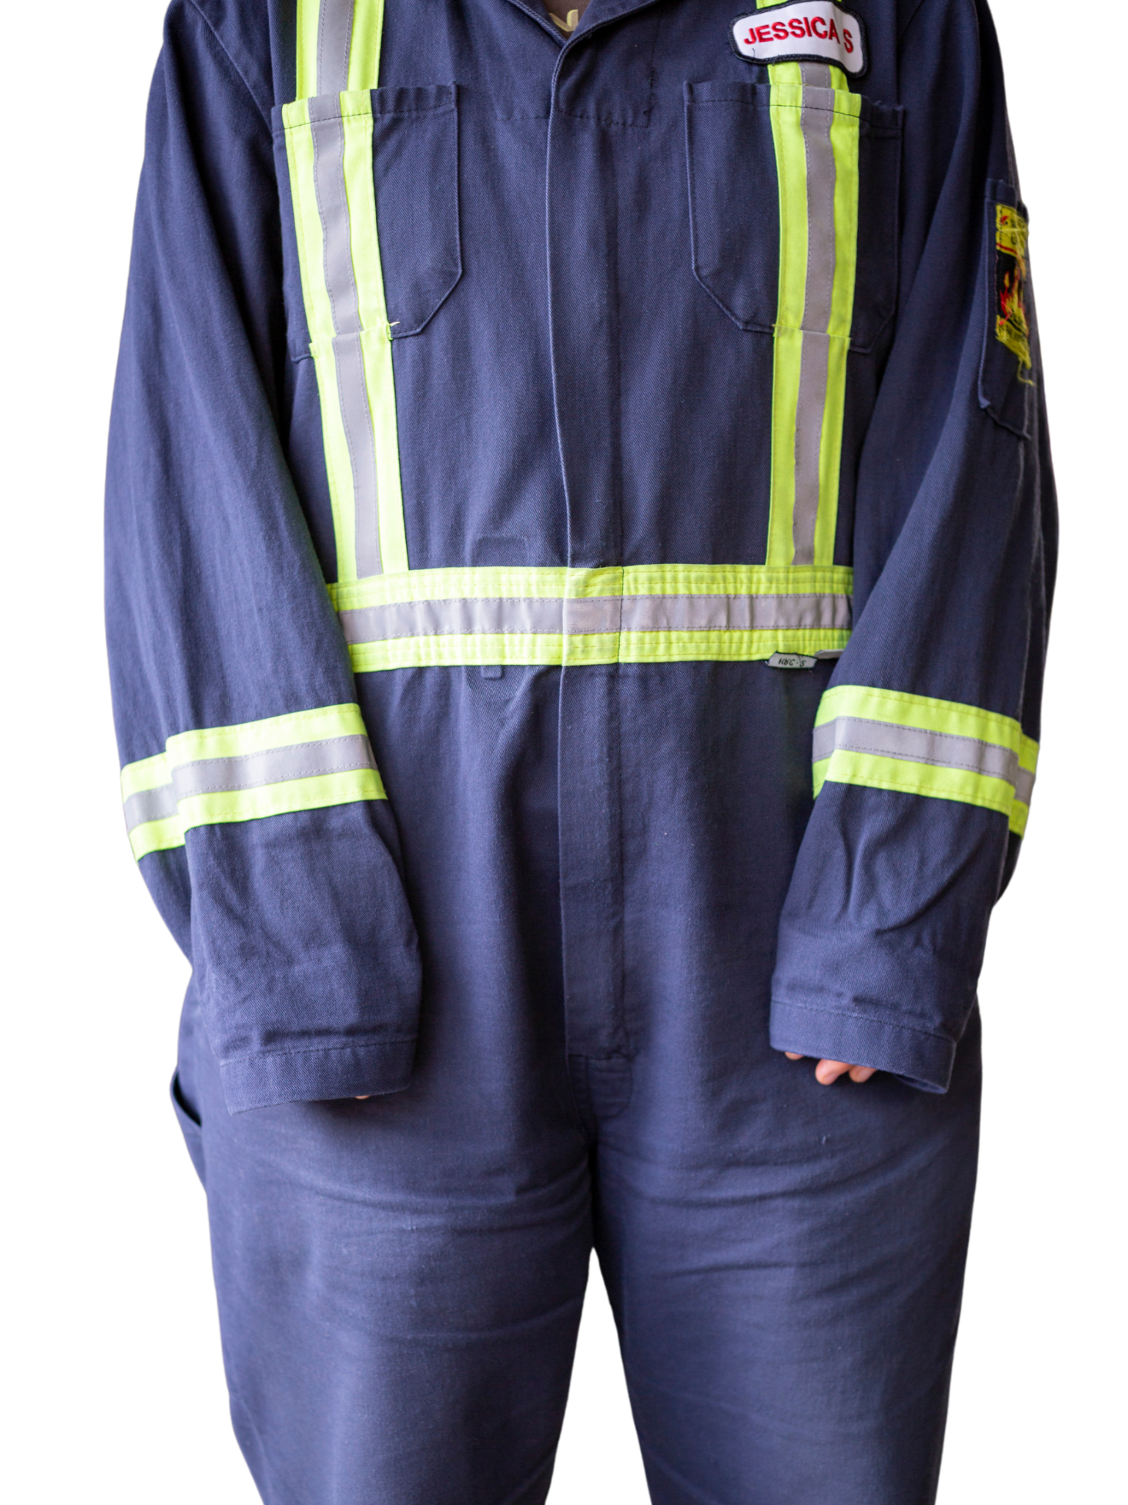
Hidden impact of Safety Coveralls
Notes:
Explain R&D of FR safety coveralls at Seaspan
-women’s group
-shoulder span and crotch height mobility restrictions
AH-HA…OH OH
To recap: women’s H&S is being impacted by wearing PPE not designed for their bodies
When asked if they were reporting near misses/incidents that are PPE related
-NO - don’t want to complain, don’t want to lose their job, male-default PPE is part of the job, don’t want to be targeted, don’t want to anger the men
-YES - but I was dismissed, they didn’t listen
Risks get normalized, cognitive distractions
THIS IS CHANGING BTW…WOMEN are starting to come forward
BUT first..back to my story…
So why is there such a discrepancy here? There is a dissonance happening…

Slide 5
The gap… is it in our policy/regs?
OHSR 8.3 PPE must:
be selected and used in accordance with recognized standards, and provide effective protection,
not in itself create a hazard to the wearer
CSA’s Z96 4.2.1:
HVSA should be constructed to ensure its correct positioning on the user and to ensure that it remains in place on the user’s body for the foreseeable period of use, taking into account ambient factors together with the movements and postures that the user could adopt during the course of work;
Note: For this purpose, appropriate means, such as adequate size ranges, must be provided to enable HVSA to be adapted to the physique’ of the user
Notes:
I looked to the current standards (read)
-regulation doesn’t acknowledge the anatomical differences between sexes
In fact it implies that women are scaled down versions of men
-no matter how many sizes are on offer, the fit/proportions will be off
So I started bothering the CSA group

Slide 6
Searching for solutions to bridge the language gap
Looking to the CSA group re: CSA Z96 - fit not on scope for revision
CSA Research Advisory Panel formed to investigate issue of PPE fit for women
literary review & cross-Canada survey
Canadian Women’s Experiences with Personal Protective Equipment in the Workplace
RESEARCH REPORT RELEASE DATE NOVEMBER 16, 2022
Notes:
Project manager in charge of revising CSA Z96, invited me to join the committee for this current round of revisions
But…had to back out…gave presentation as a guest
Heated debate…
-until recently there wasn’t a business case for it
-major voices of dissent from manuf sector, multiple women stood up and spoke to their own experience wearing PPE and framed it that it’s not a matter of if, but a matter of how soon
-asked to be a part of
-contributed to the literary review and development of a cross-canada survey, JAN, FEB 2022, over 2700 Canadian women
-thanks to all who supported getting this out
-release date, title
BUT - CSA’s stance was that they were just here to collect the data, the science, not to make a decision. They maintained that this was up to the policy/enforcement community SO..

Slide 7
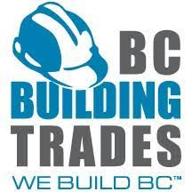
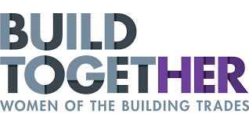
Searching for support to bridge the language gap
-ILWU local 500
-IUOE local 115
Letters of support
Notes:
While CSA research advisory group was happening, I was unconvinced that the CSA group was the avenue.
-It was explained to me that there purpose was to act as impartial third parties, to collect data, science, and provide the fact-based reports to the policy makers and the enforcement community to act
-so I set out to reach the policy makers and the enforcement community
-I presented my work to:
-they were immediately on board: specifically allies Cliff Wellicome, Rob Ashton, Jessica Isbister and Leanne Hughf and Josh Towsley
-with the BCCWITT’s Karen Dearlove we created a lobby brief and set a date to present to our MOL

Slide 8
Taking the conversation to BC’s Minister of Labour
Agreed - the issue of PPE fit is disproportionately affecting women. But is it a matter of…
?
?
?
?
?
?
?
?
?
?
?
And
/
or
Policy
Enforcement
?
?
?
?
?
?
?
Notes:
We have policy that works, but there is a gap in recognized standards - inclusive standards are needed to mandate that women’s known body data, and sex-based known statistical data/standards (textiles that’s grading, the male/female foot last for shoes..etc, in the field of medicine)

Slide 9
Taking the conversation to Work Safe BC
Agreed - the issue of PPE fit is disproportionately affecting women.
To get to today’s version of equity, gender language was removed from policy.
It will take a few years to create inclusive policy language which acknowledges anatomical differences between the sexes.
TAKING ACTION - Work Safe BC is working on a guideline to roll out as an immediate stop-gap.
Notes:
Like Steven Ma said, we DO need safety by design, but that means we have to start designing using the data and the science for both sexes

Slide 10
Moving Forward - A Call to Action
-ALL: maintain pressure on policy and enforcement communities
-OHS: review PPE programs with a sex-based lens
-Supervisors: educate/empower your team to foster a culture of allyship - Be More than a Bystander, see something - say something!
-Employers: set a new standard of best practise and invest in women’s PPE
Notes:
This should be more of a going concern
As women (and allies) become more empowered to speak up/report, safety records will become more of a concern
When employer and OHS professional, or the JOSH committee get together this year for the Annual review of your PPE program, and you assess the effectiveness of your control measures
-even though respirators are the only ones that include a fit test, consider looking into the fit of your PPE where women are concerned
Productivity metrics and retention and attraction of top talent-
=opportunity for forward thinking companies to make available PPE designed w women’s body data and grading rules
Thinking in terms of ESG, providing women’s PPE is a measurable step to add to a D&I program
-ALL: maintain pressure on our MOL, on WorkSafeBC, and on the CSA group to support the creation of, and to recognize, inclusive design and construction standards in Canada.
-OHS community: review PPE programs with a sex-based anthropometric lens focused on fit and rise beyond simple pass/fail PPE enforcement SEEK TO UNDERSTAND
-Supervisors: encourage reporting of PPE-related near misses/incidents, educate/empower your team to foster a culture of allyship - Be More than a Bystander, see something - say something!
-Employers: join forward-thinking companies and invest in women’s PPE as a measurable due diligence standard that will set you apart to potential investors, to your workforce, and to potential skilled labour new-hires

Slide 11
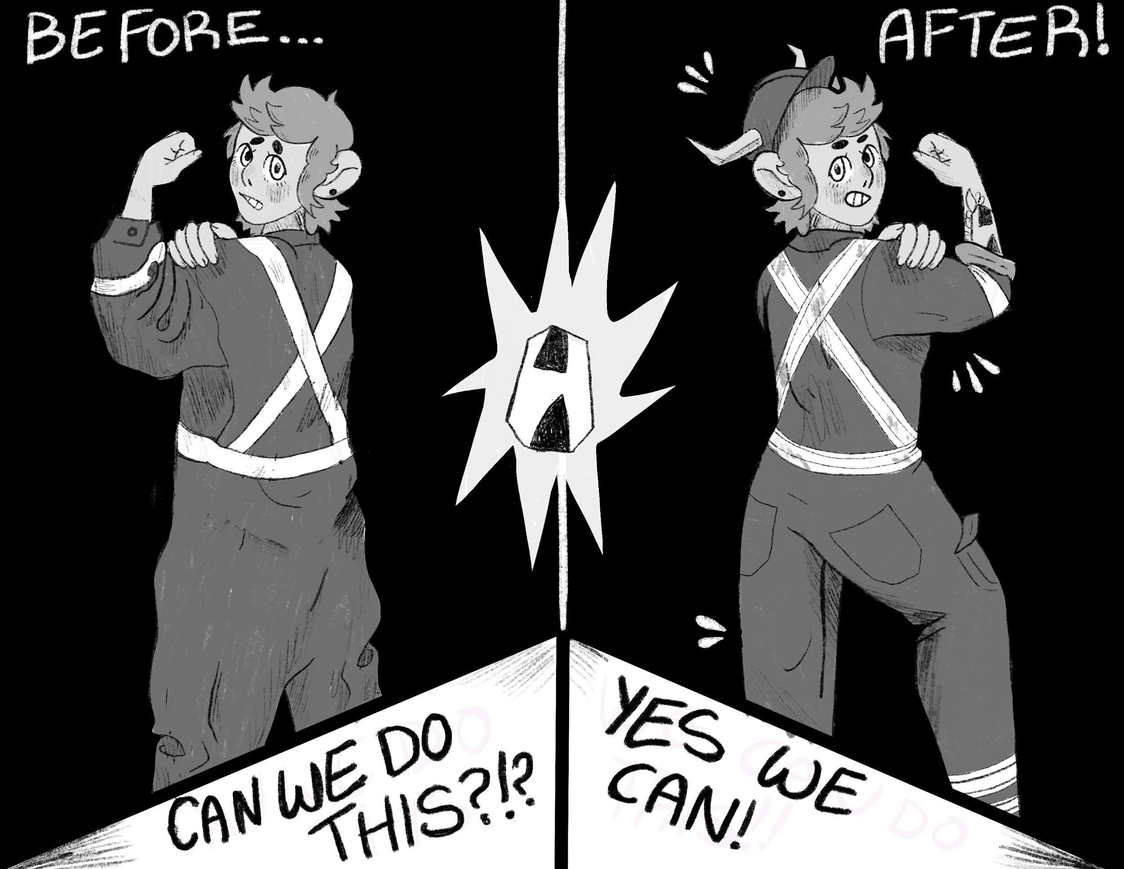
Thank-you, and let’s keep the conversation going!
LinkedIN
email jodi@helgawear.com
socials @HelgaWearInc

